Slide 1
IFMA Member Benefit of the Month Shift Happens!
Presented by IFMA Community leaders:
WE – Workplace Evolutionaries
IT – Information Technology
ESUS – Sustainability
Pat Turnbull Global Co-Chair
WE
Ted Ritter
Global Chair
IT
Dean Stanberry
Global Chair
ESUS

Slide 2
IFMA Member Opportunities to Network, Learn, Grow
CHAPTERS → Geographic Location
COUNCILS → Industry Focus
COMMUNITIES → Strategic Themes & Competencies

Slide 3
IFMA Communities Unite to Share Top Trends
IFMA’s Communities (CoP) align with
core competencies (knowledge areas) that are critical to
Facility Management effectiveness.

Slide 4
The WE Community
Pat Turnbull Global Co-Chair
WE
WE is dedicated to accelerating workplace innovation and consciousness in order to drive enhanced workplace experience and optimize business results.
Core competency alignment: Human factors, Communication, Leadership & Strategy, Finance & Business
Notes:
WE are a global community of thought leaders and cross-functional executives who are responsible for optimizing workforce effectiveness, engagement, health and well-being.

Slide 5
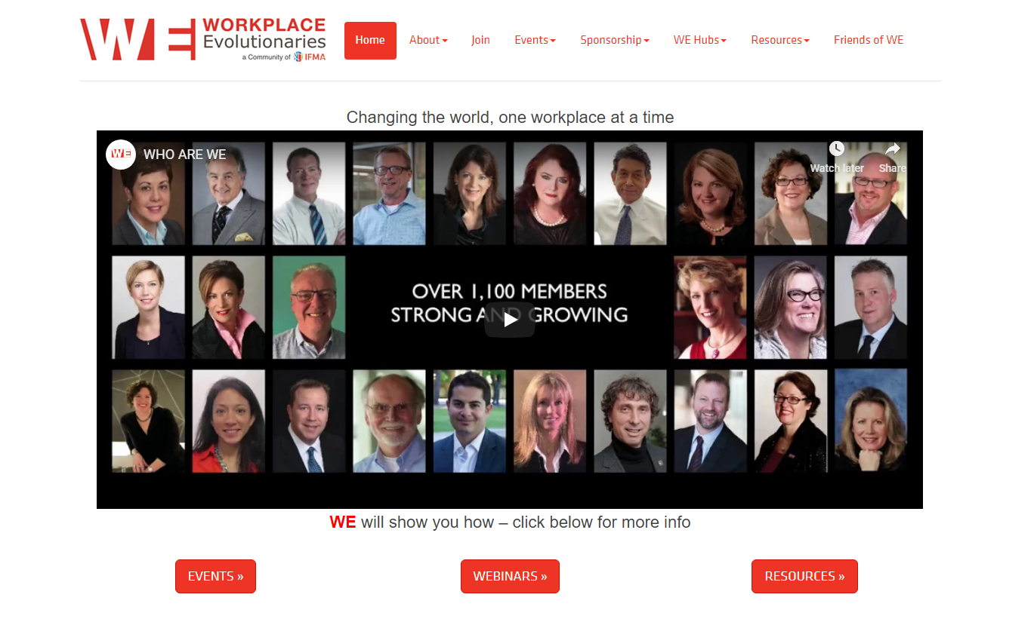
Notes:
Today, WE have passionate, diverse, leadership team and over 1000 members globally. Our motto → ‘changing the world one workplace at a time!’ And we believe…

Slide 6
WE Believe…
In empowering professionals to create, lead and implement workplace transformation that will influence the evolution of the workplace through research and knowledge sharing and will enhance workforce collaboration, productivity and experience.
We will achieve this by bringing together members and thought leaders globally to share new ideas and research which will evolve the profession of workplace strategists, facility managers and real estate professionals worldwide.
Notes:
As FMs, we directly impact human performance AND we oversee/manage many aspects of the business that represents significant investments in RE portfolios, buildings, (structures, interiors, grounds) and tech technology and the way we work.

Slide 7
Accelerating Workplace Innovation & Consciousness
OPERATIONAL
EXCELLENCE
STRATEGIC
FOCUS
TRANSFORMATIONAL
IMPACT
Infrastructure
& Technical
Competencies
Business & Organizational
Competencies
Innovative & Transformational
Competencies
Individual / Team
Contributors
Team / Organization
Contributors
Organization / Ecosystem
Contributors
Notes:
Our WE members are diverse in their backgrounds and expertise ranges from operational excellence to strategic to transformational. And we represent a CROSS-FUNCTIONAL perspective:
Our members come from Corporate Real Estate, Facilities Management, Design, Architecture, Academia, Technology, Sustainability, HR, Organizational Design, Workplace Strategy and Change Management….and many more.

Slide 8
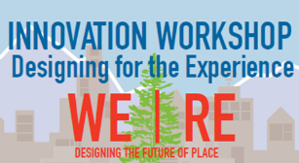
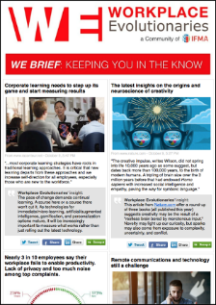
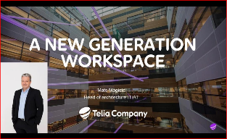
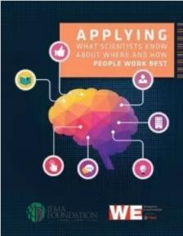
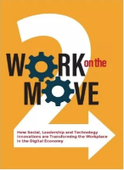
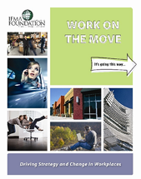
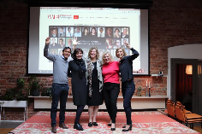
What WE Do
Notes:
NETWORK WE Programs (WWP, FF, WWPE, RICS) and WE HUBS
KNOWLEDGE WE Research, WE Brief, WE books/whitepapers
LEARNING Higher Ed Curriculum and

Slide 9
Top Workplace Shifts IG SHIFTS
Cultivate Resiliency
Accelerate Human Performance
Measure What Matters
Notes:
We started this conversation in Charlotte at WWP. Our Communities hosted an all day forum to discuss major trends/industry shifts that impact on FM. WE leveraged our Collective Intelligence by asking our global WE leaders from around the world to share “What they see happening and what they know for sure”.
I organized the feedback into three primary themes to share with you today. Given the time, we will keep the conversation at a high-level. But, as you listen carefully to all the speakers, I think you will hear some VERY interesting strategic themes that cut across each of our practice areas.

Slide 10
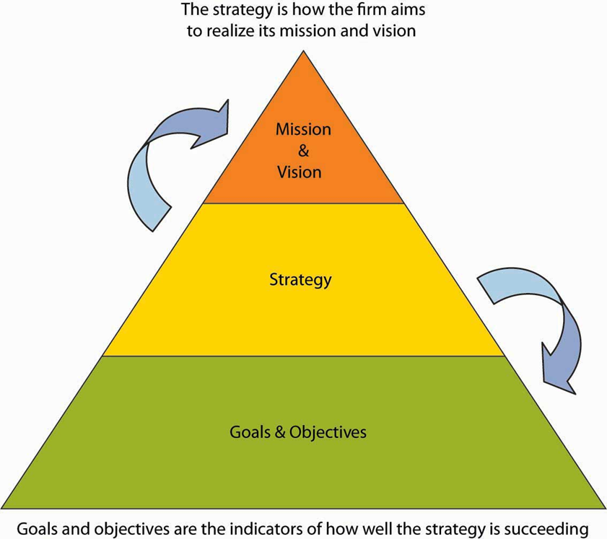
Cultivate ‘Resiliency’ Our capacity (attitudes and skills) to respond to pressure and the demands of daily life
How can a resilient workplace cultivate high performance teams and engaged employees who are empowered to fulfill their potential?
Workplace
Real Estate
Personal
Notes:
Simply put Resiliency is our capacity (attitudes and skills) to respond to pressure and the demands of daily life
Workplace Resiliency
Strategy 1st – Align WPS with organizational & business strategy, prepare for emerging digital implications, changing workforce, develop scenarios
Business Goals & Objectives
A multi-disciplinary PofV
Scenarios/strategies/budgets
Measurements that Matter
Create a holistic workplace strategy/experience that includes both the physical and virtual to Engage and Empower the people using design thinking
Future Proof In addition to traditional FM strategies such as Disaster Recovery and Preventative Maintenance. FM can drive design strategies that provide high levels of Flexibility & Choice as well as adaptive design concepts
Adaptive Design, Universal Design, Kit of Parts
Agile Organizational Structure
Support Technology
2. Real Estate Resiliency –
1. Portfolio assessments that consider the future workforce – who are they, where do they go to school? Where will they live? - Amazon
2. Consider SAAS – Space As A Service – Enterprise offerings at WeWork, Alt Office/ Liquidspace and Steelcase, and many others
3. Leverage your Building Amenities! Social spaces, wellness offerings, learning environments.
3. Personal Resiliency
1. Lean in. How we approach life (personally) and our approach to the work we do will enable us to live better despite circumstances
2. Emotional Intelligence - how we engage with multi-disciplinary partners and how we create our own work/life balance. Life Long Learning
3. BE the Change

Slide 11
Accelerate Human Performance
Cost of RE is nominal compared to people and productivity.
It’s still all about People!
Humanize the Workplace
Engage & Empower through UX
Notes:
It’s still all about people! Cost of RE is nominal compared to people and productivity.
80% of org spend goes to human capital vs the 20% on RE, Tech and Operation
Goal should be focused on how to accelerate human capital and performance
How can workplace be used as a talent magnet? A place so powerful, that you want to come. A place that makes you feel good and inspired?
Create a workplace that helps people feel better - Humanize the workplace
We know that when you feel better, you perform better. This includes physical, mental (cognition) and emotional well-being
By focusing on: air, water, food, nourishment, light, fitness, comfort and mind we will increase well-being, cognitive powers and happiness. Given the statistics of depression, this will be vitally important.
Stimulate all senses and integrate biophilia to remind us of how good it is to be human
Engage and Empower through Experience
Provide choice, opportunities to connect, socialize, focus and restore.
CXO –create, own and evolve UX, eliminate friction and to create happy workforce
Use Predictive analytics to evolve and support new behavioral shifts
Harvard University: The Cog Fx Study / Harvard T.H. Chan School of Public Health’s Center for Health and the Global Environment
Researched the impact of indoor environmental quality on well-being and staff cognitive ability
Assessed high-performing non-certified buildings and LEED-certified green buildings
61% higher cognitive test scores
6% higher sleep quality scores
30% experience less absenteeism related to sickness
By 2030 the largest health risk on earth will be depression. The global economic impact of mental health is estimated at US$ 1 trillion per year in lost productivity.

Slide 12
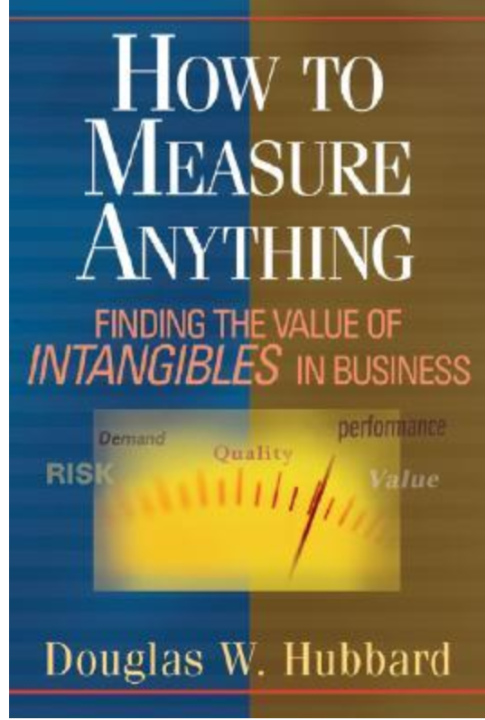
Measure What Matters
An effective goal-setting system starts with leaders who take time to decide what counts. If we try to focus on everything, we focus on nothing.
Define Success
Use the Data
Don’t Stop – analyze, share, learn, evolve!
Notes:
Define success and measure it
Starting w Strategy & Vision, - Identify what matters most and how to measure that.
Keep it as simple as possible (Wendy’s example)
Recent research showed executives want to simplify and focus.
According to our latest global benchmarking study, we measure what’s easy not what’s most important – costs per sq ft, utilization, satisfaction but we shy away from those that are impacting human capital and performance (WLB, productivity, etc
WE has hosted a number of session on how to measure productivity and created ROI on those things that cause friction and are productivity busters. There is also a great book called How to Measure Anything by Douglas Hubbard
Consider timing/budgets as well as long term objectives. We all want metrics up front to help us sell the project, ideas but sustaining them requires allocation of funds and responsibilities with HR, RE and IT
Analyze, Share, Learn and Evolve AND…
Use the Data
To make informed decisions
Develop ROI’s to create and sell your strategy- ROI
To capture Leadership Endorsement to Lead the Change and provide robust case studies to support others and leverage your brand by communicating a great place to work
Don’t stop!
If you define WPS as the alignment of the wp to the organizational strategy, it will continually evolve as does the organization
Use your data to help you not only evolve, but thrive. Support Change with continuous improvement thinking: a process that embraces change and encourages co-creation of the experience. Secure executive involvement early and never let them go
Lastly, use this as your scorecard to communicate your success and impact.

Slide 13
The IT Community
We want to collaborate to share the best case studies!
The IT Community is committed to providing appropriate and relevant content to the GLOBAL IFMA and RICS membership utilizing a broad range of communication and publication platforms.
“How does Technology Support FM Operations?”

Slide 14
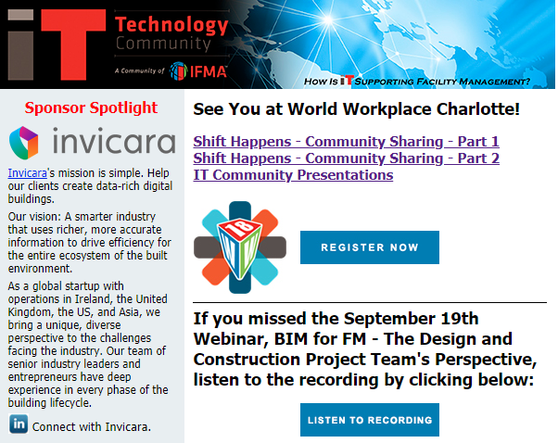
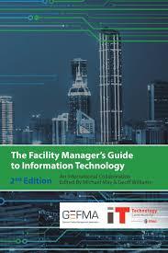
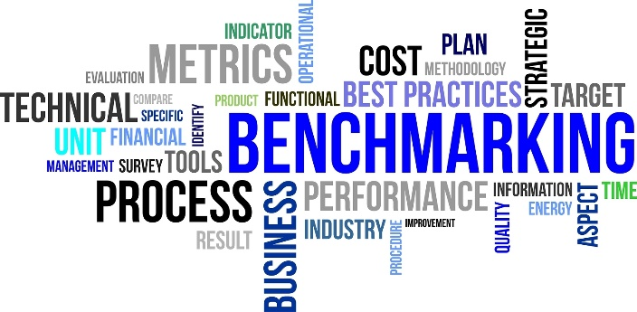
ITC – What we do

Slide 15
IoT Impacts on Soft & Hard FM
The modern workplace is being enhanced with the introduction and proliferation of sensors. A carefully crafted plan is needed
The technologies available today to manage infrastructure more efficiently with the augmentation of disparate sensor data, weather in combination with historical data of maintenance performed. The days of reactive maintenance should be over – but they are not.
Notes:
Chip Production vs Sensor Production
IOT – what no is talking about
Installing / Maintaining / Calibrating / Replacement – another life cycle
So, whilst the trend is agreed, the numbers are disputed. By 2019, PwC predicts 25% of tasks across every job category will be automated. The Oxford Martin School goes so far as to suggest almost half of jobs done today in the US alone (47%) could potentially be automated over the next two decades. Forecasts for fully automated jobs, though, typically fall into single figures, with WEF predicting some 60% of jobs have scope for at least 30% automation.
Instances of job losses through automation in industrial and manufacturing sectors are making the news. The recent story of a factory in China replacing 90% of workers with robots and seeing a 250% leap in productivity is typical. However, white-collar roles in financial markets are also facing the axe. Wall Street firms have been busy automating, steadily replacing human traders with algorithms and cutting around 1 in 3 jobs between 2000 and 2013, despite transaction volumes going up. A major Dutch bank is replacing nearly 6,000 people with machines, in a move costing $2 billion, but saving $1 billion a year.

Slide 16
Analytics & Real Time Insights
We are already beyond information overload!
The number of agnostic providers have grown exponentially. The availability of integrated analytics & AI within FM & CRE technology platforms is also significant.
Which way should you go?
“The goal is to turn data into information, and information into insight.” Carly Fiorina
Notes:
So, whilst the trend is agreed, the numbers are disputed. By 2019, PwC predicts 25% of tasks across every job category will be automated. The Oxford Martin School goes so far as to suggest almost half of jobs done today in the US alone (47%) could potentially be automated over the next two decades. Forecasts for fully automated jobs, though, typically fall into single figures, with WEF predicting some 60% of jobs have scope for at least 30% automation.
Instances of job losses through automation in industrial and manufacturing sectors are making the news. The recent story of a factory in China replacing 90% of workers with robots and seeing a 250% leap in productivity is typical. However, white-collar roles in financial markets are also facing the axe. Wall Street firms have been busy automating, steadily replacing human traders with algorithms and cutting around 1 in 3 jobs between 2000 and 2013, despite transaction volumes going up. A major Dutch bank is replacing nearly 6,000 people with machines, in a move costing $2 billion, but saving $1 billion a year.

Slide 17
Cyber Security & Personal Privacy
What could a malicious individual do to your facility if they had access to your Building Control System?
What liabilities do Facility Managers have?
How do we address privacy concerns and are they generationally different?
What is the most secure communication technology?
How has and will GDPR affect us?
Notes:
So, whilst the trend is agreed, the numbers are disputed. By 2019, PwC predicts 25% of tasks across every job category will be automated. The Oxford Martin School goes so far as to suggest almost half of jobs done today in the US alone (47%) could potentially be automated over the next two decades. Forecasts for fully automated jobs, though, typically fall into single figures, with WEF predicting some 60% of jobs have scope for at least 30% automation.
Instances of job losses through automation in industrial and manufacturing sectors are making the news. The recent story of a factory in China replacing 90% of workers with robots and seeing a 250% leap in productivity is typical. However, white-collar roles in financial markets are also facing the axe. Wall Street firms have been busy automating, steadily replacing human traders with algorithms and cutting around 1 in 3 jobs between 2000 and 2013, despite transaction volumes going up. A major Dutch bank is replacing nearly 6,000 people with machines, in a move costing $2 billion, but saving $1 billion a year.

Slide 18
Specialized Staff
Given the increasing complex nature of the technologies in our FM world – how do we maintain it and get the most out of it’s capabilities?
“Complaining about a problem without posing a solution is called whining.” Theodore Roosevelt
The shift is to hire and FM Technologist and possibly Data/Business Analyst!
Notes:
So, whilst the trend is agreed, the numbers are disputed. By 2019, PwC predicts 25% of tasks across every job category will be automated. The Oxford Martin School goes so far as to suggest almost half of jobs done today in the US alone (47%) could potentially be automated over the next two decades. Forecasts for fully automated jobs, though, typically fall into single figures, with WEF predicting some 60% of jobs have scope for at least 30% automation.
Instances of job losses through automation in industrial and manufacturing sectors are making the news. The recent story of a factory in China replacing 90% of workers with robots and seeing a 250% leap in productivity is typical. However, white-collar roles in financial markets are also facing the axe. Wall Street firms have been busy automating, steadily replacing human traders with algorithms and cutting around 1 in 3 jobs between 2000 and 2013, despite transaction volumes going up. A major Dutch bank is replacing nearly 6,000 people with machines, in a move costing $2 billion, but saving $1 billion a year.

Slide 19
The ESUS Community
Environmental Stewardship, Utilities and Sustainability is a strategic theme and core competency of the facility manager that touches every aspect of the association.

Slide 20
What we do

Slide 21
Renewable Energy & Smart Buildings
Forward-thinking organizations are combining smart buildings, energy efficiency and renewable energy to reduce their overall impact on the environment
Many new options have made it easier and cheaper to buy renewable energy for all or part of a building – PPAs, VPPAs, RECs
Renewable energy procurement can be more cost effective (with less price volatility) than traditional electricity contracts in many regions across the country
Cheaper sensors and web-based platforms are making it easier to implement “smart building” IoT solutions to save energy and improve comfort

Slide 22
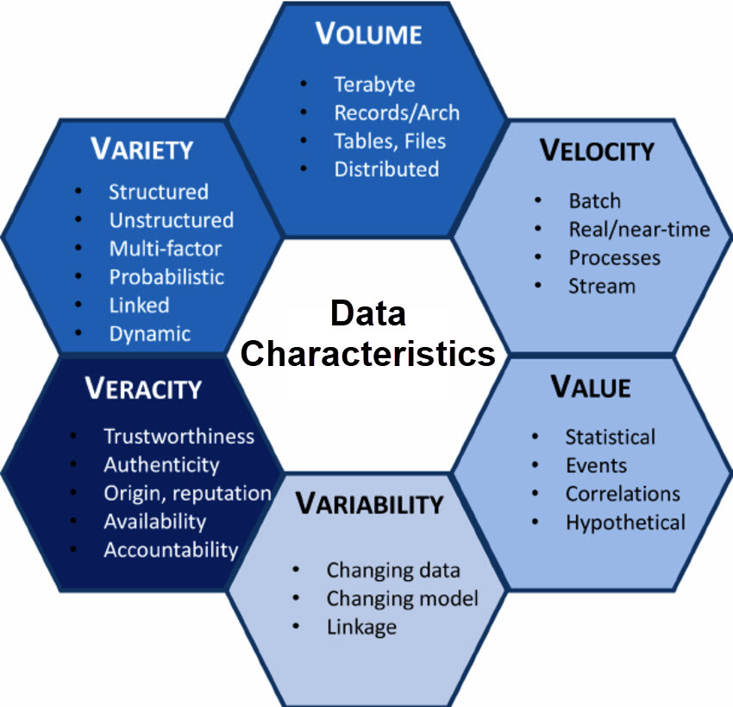
Converting Data to Information, and Information to Insight
Data Analytics skills will become increasingly important to the FM professional. These skills will need to go beyond creating sleek charts and graphs. FM’s will need to first understand the characteristics of their data;
What makes it good data?
What is its value?
Is the source trusted?

Slide 23
Wellness & Wellbeing
The green building movement has expanded to include the “well building” movement;
Increased awareness of buildings’ impacts on human health driving changes in new and existing buildings
Inexpensive sensors and controls can tailor lighting, temperature, humidity and fresh air to improve comfort
Studies tying indoor wellbeing to worker productivity and therefore output / profits of organizations
New certifications for healthy buildings – WELL, Fitwel

Slide 24
Join Communities Today! $55.00
For more information visit our Community Web sites:
WE.IFMA.org IT.IFMA.org ESUS.IFMA.org
Notes:
And remember….

Slide 25
Questions?

